Slide 1


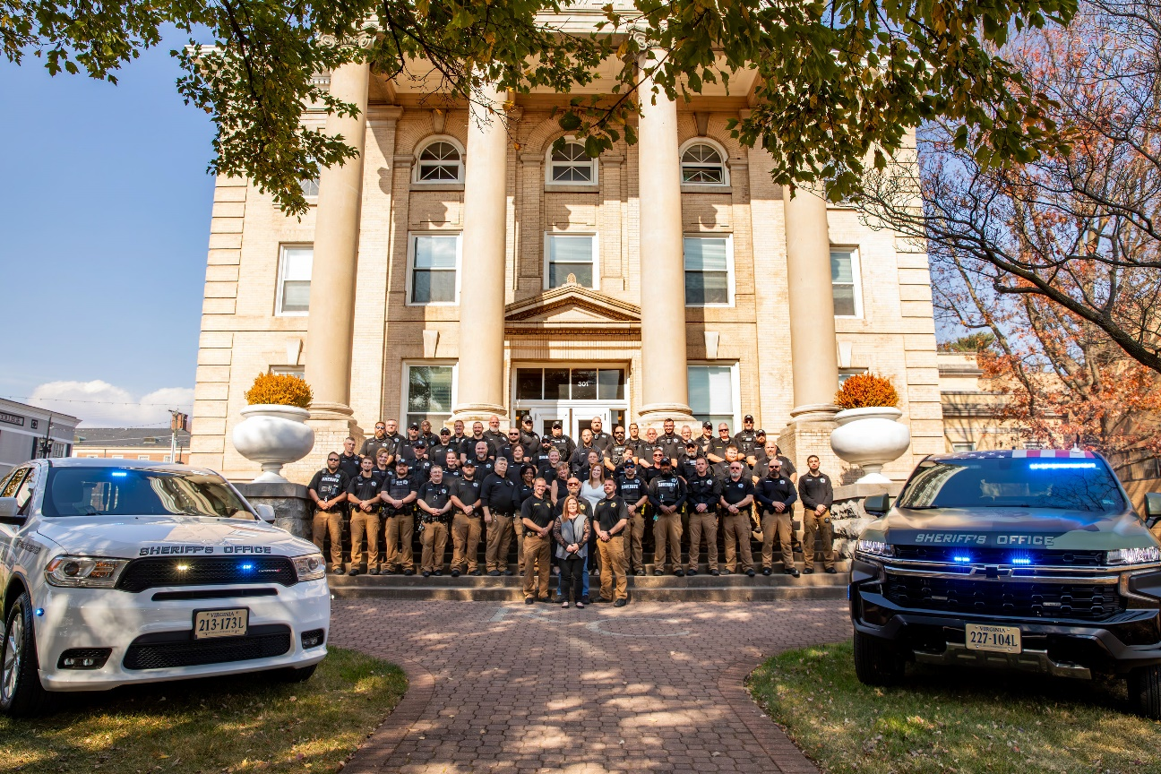
ROANOKE COUNTY
SHERIFF’S OFFICE
Service Respect Dedication Honor
2023 Annual Report
Notes:
R

Slide 2



STAY CONNECTED
https://www.roanokecountyva.gov/89/Sheriffs-Office
https://www.facebook.com/RoanokeCountySheriff

Slide 3
TABLE OF CONTENTS
Section | Page #
Meet the Sheriff | 4
Letter from the Sheriff | 5
History | 6
Accreditation | 7
Financial Summary | 9
Grants | 10
Command Staff | 11
Administrative Division | 12
Community Outreach | 14
Special Olympics | 22
Drug Take Back Box | 23
School Resource Program | 24
Operations Division | 25
Corrections | 26
Jail Services and Programs | 30
Court Services Division | 41
Special Units | 44
Promotions | 46
Service Awards | 50
Retirement | 52

Slide 4
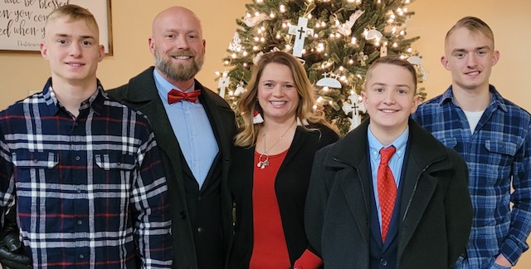
MEET THE SHERIFF
Sheriff Orange is a native of the Roanoke Valley and after a brief time away with the U.S. Army, returned here to raise his family. Sheriff Orange is a graduate of Liberty University and has served the Valley in public safety since 2001. Sheriff Orange is a forward thinking, community-oriented Sheriff, who takes great pride in the opportunity he has been given to serve the citizens of Roanoke County as their Sheriff. Sheriff Orange, along with his wife Beverly, and three sons are very active in the community and their local church, through a number of different service and volunteer responsibilities. Sheriff Orange believes that his years of experience in Law Enforcement and Corrections, along with a desire to serve, help to build and foster positive relationships throughout the community. Sheriff Orange welcomes community input and asks that citizens not hesitate to contact him with questions, concerns or suggestions.
“It is a blessing and an honor to serve the citizens of Roanoke County as their Sheriff and it is my goal to ensure we provide our citizens with the highest level of service possible.”
“

Slide 5
LETTER FROM THE SHERIFF
Dear Roanoke County Citizens,
Over the course of the past year, we have had the opportunity to renew outreach programming and partnerships throughout the Valley. We are excited about what the new year holds and the opportunities for service that will be presented.
During this past year, our staff has continued to work with our partners at Roanoke County Public Schools and RCPD to increase the number of School Resource Deputies serving our elementary schools. Through this partnership, the RCSO has utilized funding provided by RCPS and now RoCo to hire and train School Resource Deputies; who are deployed through the County serving our 16 elementary schools.
This past year also saw our staff take the bold move of transitioning from the state accreditation in our law enforcement operations to the process of seeking national accreditation. As the new year begins, I am excited about the continuation of many outstanding programs and services as well as the pursuit of new endeavors.
The success of the RCSO is a credit to the amazing staff that faithfully serve the citizens of our community on a daily basis. Our success is also due to the support we receive from you, our citizens. Thank you for all that you do and for allowing us to serve you.
Sincerely,
Joseph “Eric” Orange
Sheriff Roanoke County

Slide 6
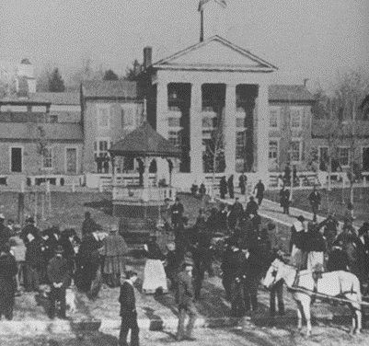

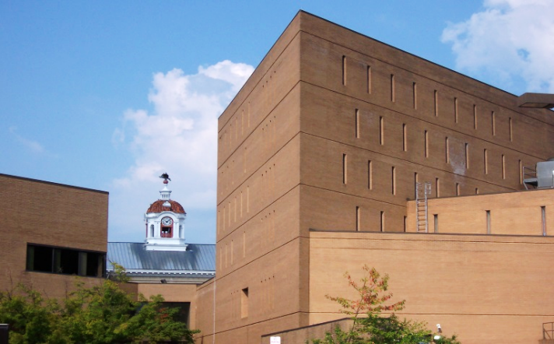
HISTORY
The Roanoke County/Salem Jail Complex is part of the Roanoke County Court Complex located at 401 East Main Street in the City of Salem, Virginia. The facility is operated by the Roanoke County Sheriff’s Office and provides correctional services for the City of Salem, County of Roanoke, and the Town of Vinton. The population of The County of Roanoke and the City of Salem is approximately 94,486 and 25,325, respectively.
The jail facility has a rated capacity of 108, and does not house juvenile offenders. The first level of the facility includes the sally port, magistrate’s office, intake/booking area, classification holding cells, medical and handicapped cells, visitation monitors, medical section, central control and jail administrative space. The second floor contains the classification section and inmate programs including the library, a multi-purpose classroom, gymnasium, laundry, food services and maintenance.
The jail is a six story brick structure covering 63,000 square feet. The jail was completed in 1979 by VVKR Incorporated and J.M Turner & Company, INC. The jail officially opened in 1980. The new facility replaced an overcrowded and antiquated Roanoke County Jail which was built in 1920 and was commonly referred to as the “Temple of Justice.”

Slide 7
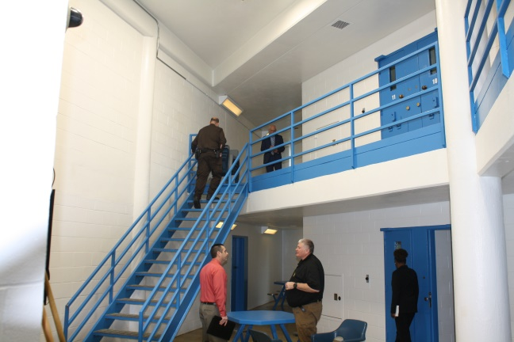

American Correctional Association
ACCREDITATION
The Roanoke County Sheriff’s Office received its initial accreditation in August 2000 and has been re-accredited every three years for a total of eight on-site audits. The primary advantage of being an accredited facility is having clearly defined policies and procedures, and ultimately enhancing consistency in operations. Accreditation provides an agency with credibility among its peers, law makers, the courts and the public. The Roanoke County/Salem Jail is one of 14 local jails in Virginia and 98th out of over 4,000 local jails nationwide to achieve accredited status by ACA. Sheriff’s Office staff and their records are thoroughly examined every three years by a professional audit team to ensure compliance with the 383 standards necessary for accreditation.
The standards cover areas such as the jail’s administrative operations, budget/fiscal management, staff training, inmate records, jail security & operations, inmate classification & discipline, physical plant, food service, safety & sanitation, health care and other inmate services & programs. To be accredited by the ACA, a jail must be in compliance with 100% of the mandatory standards (60) and 90% of the non-mandatory standards (323). We maintained compliance with 100% of the mandatory standards and 99.3% of the non-mandatory standards during the re-accreditation that took place in 2021.

Slide 8

Commission on Accreditation of Law Enforcement Agencies
ACCREDITATION
In 2023, the Roanoke County Sheriff’s Office chose to seek accreditation from the Commission on Accreditation of Law Enforcement Agencies (CALEA). The Sheriff’s Office was previously accredited by a state agency, the Virginia Law Enforcement Professional Standards Commission (VLEPSC). In an effort to continue to grow as a department, we have chosen to seek national accreditation.
CALEA was created in 1979 as a credentialing authority through the joint efforts of law enforcement’s major executive associations. The CALEA Accreditation program seals are reserved for use by public safety agencies that have demonstrated compliance with CALEA Standards and have been awarded CALEA Accreditation by the Commission. Some benefits of participation in CALEA accreditation include increased community advocacy, support from government officials, reduced risk and liability exposure, and greater accountability within the agency.
The CALEA accreditation process has five phases: enrollment, self-assessment, assessment, commission review and decision, and maintaining compliance and re-accreditation. Our accreditation team is diligently working to make necessary revisions to existing policies and implement new policies geared toward our law enforcement functions.

Slide 9
FINANCIAL SUMMARY
Budgetary Information
The total budget for the Sheriff’s Office for 2022/2023 was $13,040,287
The adopted budget for 2022/2023 is $13,040,287
Expense
Categories
The total expenditures were $11,873,238
Personnel – 66%
Operating – 33%
Capital – <1%
Revenues for 2023
Medical Co-Payment - $6,159.89
Daily Fees – $25,852.65
Weekender Fees - $3,467.00
Canteen - $139,251.81
City of Salem - $319,589.18
State Reimbursements - $219,744.68

Slide 10
GRANTS
The Sheriff’s Office applies for grants to supplement our budget for enhancement of safety and security for staff, citizens, and inmates in addition to improving community relations through education.
The Sheriff’s Office received the following grants during the 2023 year:
Grant | Project | Amount
Bulletproof Vest Partnership Grant (BVP) | Bulletproof Vests | $7,357.28

Slide 11
COMMAND STAFF
Sheriff Orange
Business Coordinator
Administrative Lieutenant Colonel
Operations Lieutenant Colonel

Slide 12
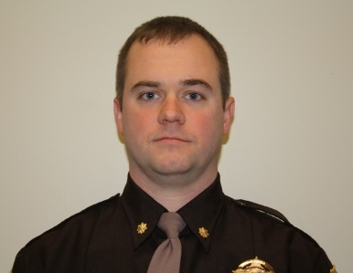
LTC. ADMINISTRATION
Lieutenant Colonel, Brent Hudson, Chief Deputy of Administration, has been serving in a law enforcement role since 2001. This position exercises line authority over operations personnel in the day-to-day operation of the Sheriff’s Office. He also ensures orders from the Sheriff are carried out and the mission of the Sheriff’s Office is met. Each Lieutenant Colonel assumes command over their division in the absence of the Sheriff.
Letter from Lt. Colonel Hudson
After transitioning from the Chief Deputy of Operations to Chief Deputy of Administration, I have taken a proactive approach with giving the employees everything possible to ensure our success. I feel that our employees are the most important part of the department. The employees are the direct reason why we were so successful in the past year at not only completing our essential functions, but serving the community in many new ways.
In the past year, I have focused on acquiring advanced training for our staff to better prepare them for our ever-evolving mission. We have sent several staff members to state and nationally recognized schools such as PELS and NJLCA which is essential in the growth of our leadership.
Our School Resource Deputies have integrated nicely into their assigned schools and have been well accepted by students, staff, and parents. These deputies take part in school safety checks, investigations, positive interactions with students, and many different civic events throughout the schools.
I am confident that 2023 will bring many new opportunities for the department to grow and better serve the community.
Sincerely,
LTC Brent Hudson
Chief Deputy of Administration

Slide 13
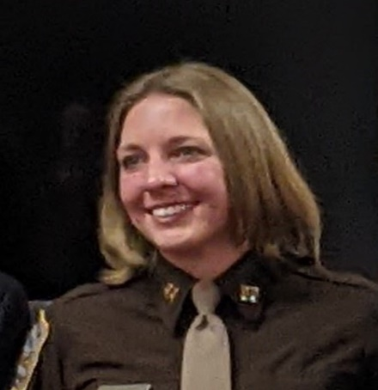
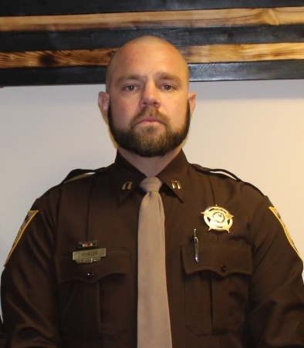
ADMINISTRATIVE DIVISION
Stacy Olsson has been a member of the Roanoke County Sheriff’s Office since 2008. She has served at various supervisory levels in both the corrections and civil divisions. She has attended the Professional Executive Leadership School through the University of Richmond, the FBI LEEDA Executive Level Leadership School, and the Batten Leadership Institute. She graduated Cum Laude from the University of Central Florida with two Bachelor of Science Degrees in Criminal Justice and Psychology, with a minor in Sociology. She earned Undergraduate Certificates in Behavioral Forensics, Criminal Profiling, and Crime Scene Investigation. While at UCF, she was inducted into the Golden Key International Honor Society and the Honor Society of Phi Kappa Phi. She then graduated with high distinction from Liberty University with a Master of Arts in Executive Leadership. She was also inducted into the Sigma Beta Delta Honor Society and the Omega Nu Lambda Honor Society.
Administrative Captain Stacy Olsson
solsson@roanokecountyva.gov
Administrative Lieutenant
Academy
Professional Standards Unit
Community Outreach/ School Resource

Slide 14
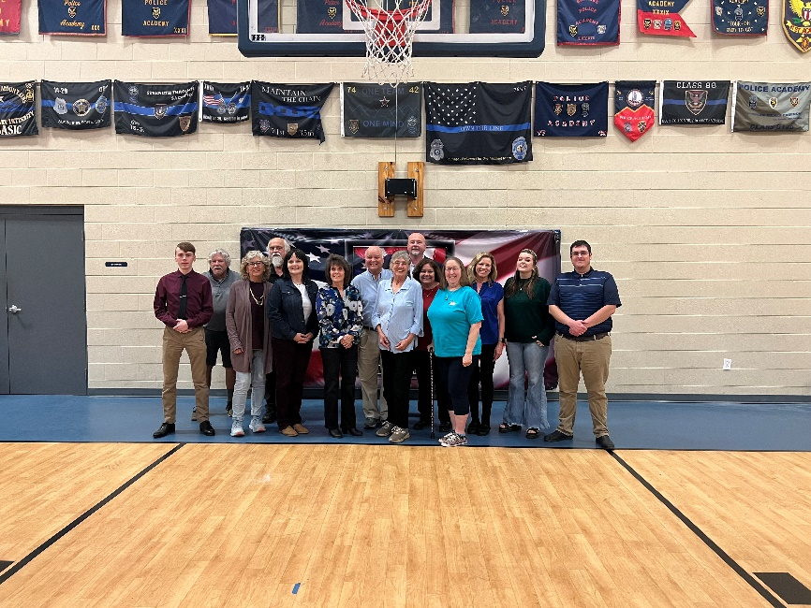
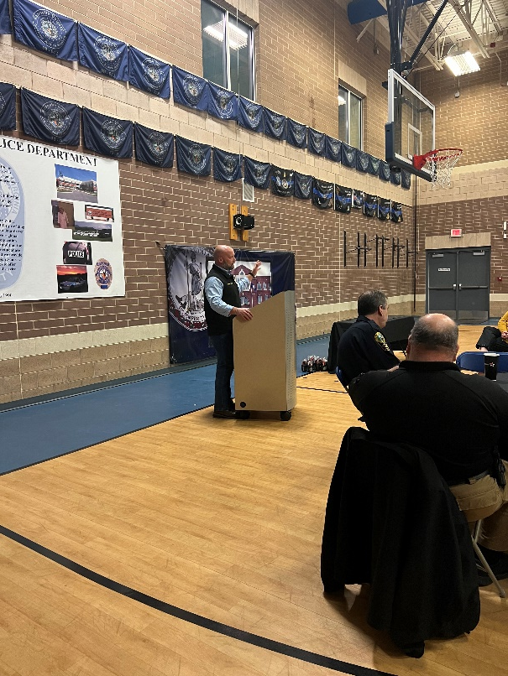
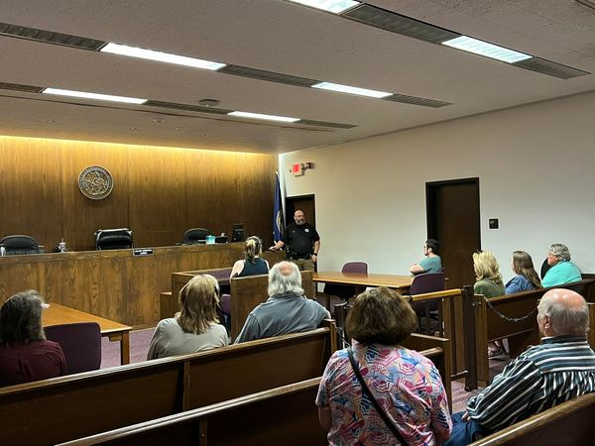
COMMUNITY FIRST
Roanoke County Public Safety Academy
The Sheriff’s Office has partnered with the Roanoke County Police Department, Roanoke County Fire and Rescue Department, and the Western Virginia Regional Jail to host a joint Public Safety Academy. This Academy covers numerous topics such as investigations, court security, budget, accreditation, evidence, and special projects. The Academy also allows citizens to participate in field exercises including firearms and emergency vehicle operations.

Slide 15
COMMUNITY- BASED SERVICE
Other Community Outreach
Firearms Safety Classes – teaches safety to Roanoke County citizens
Avoid (Awareness, Verbalize, Overcome, Identify, Distance ) Classes
RAD (Rape Aggression Defense) Woman’s Self Defense Classes
CRASE (Civilian Response to Active Shooter Events)
Participate in Neighborhood Watch Programs
Participate in Roanoke County Public Safety Academy and Alumni Groups
Jail Tours to Criminal Justice Students
SRO Deputy Program
Identify-A-Kid Program
Car Seat Safety and Installation
Identify-A-Kid
The Sheriff’s Office implemented the Identify-A-Kid program early in 2017. It provides parents/caregivers with an identification card of their children containing pertinent information in the unfortunate event that the child goes missing. Fingerprinting of children is also offered.
Citizens Firearm Safety Course
This program was initiated in 2016 to educate the public about their rights, how to safely handle, and store a firearm. The citizens are asked to bring in can food items for donations to local food banks in lieu of fee for attending the class.
2023 :
35 Classes were taught
Over 200 Citizens attended
1505 Pounds of food were donated to local food banks

Slide 16
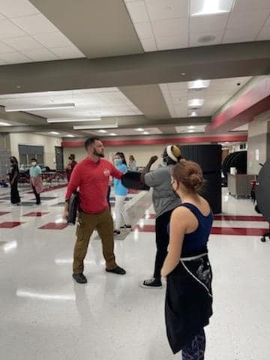
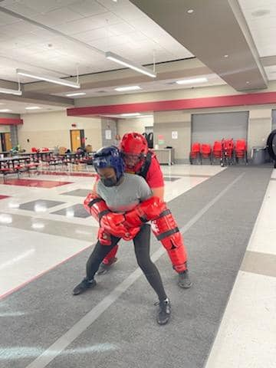
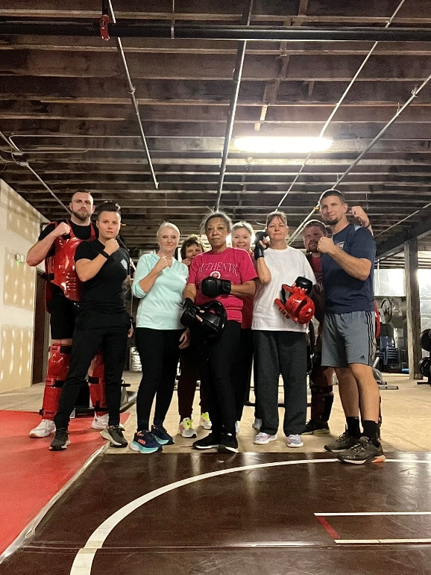
BUILDING PARTNERSHIPS
AVOID
This program was initiated by our department in 2016 and is instructed to anyone of any age interested in learning about personal awareness and practical self-defense. We request donation of 10 non-perishable food items per participant.
2023
Classes Instructed = 13

Slide 17
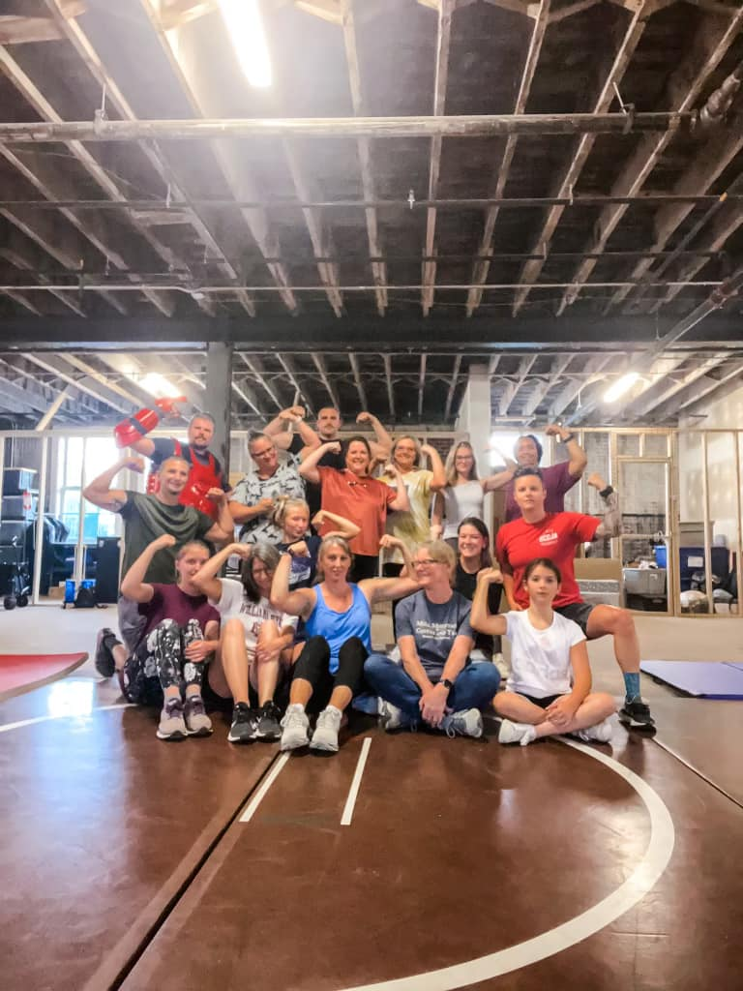
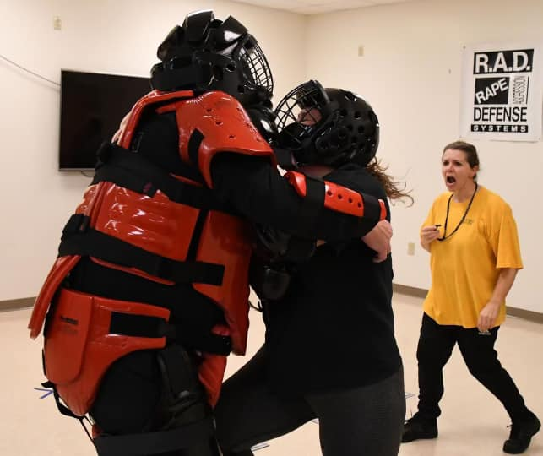
EMBRACING THE COMMUNITY
Rape Aggression Defense
R.A.D. is the largest organization of its kind and the only such organization or program to be endorsed by the International Association of Campus Law Enforcement Administrators (IACLEA), the National Self Defense Institute (NSDI) and the National Academy of Defense Education. Currently the Roanoke County Sheriff’s Office has four certified instructors. The course is instructed over the period of 12 hours broken into 4 separate classes. R.A.D. was implemented by the Sheriff’s Office Community Outreach Program in 2017. We offer this program to all Roanoke County High School females who would like to take this course. We also offer the course to all females within the greater Roanoke Valley.
Citizen Volunteers
The Sheriff’s Office established a Citizen Volunteer Program on July 30, 2012. This program is available to citizens 21 or older. Volunteers are typically utilized 6-10 hours per week performing duties in Court and Inmate Services.

Slide 18

EMBRACING THE COMMUNITY
Citizens Response to Active Shooter Events
In 2023 we began offering CRASE. Law enforcement officers and agencies are frequently requested by schools, businesses, and community members for direction and presentations on what they should do if confronted with an active shooter event. The Civilian Response to Active Shooter Events (CRASE) course, developed by ALERRT in 2004, provides strategies, guidance and a proven plan for surviving an active shooter event. Topics include the history and prevalence of active shooter events, civilian response options, medical issues, and considerations for conducting drills. Since it’s inception, our certified instructors have taught many courses to schools, civic groups, church groups, and more. This course has been extremely well received by our community.

Slide 19
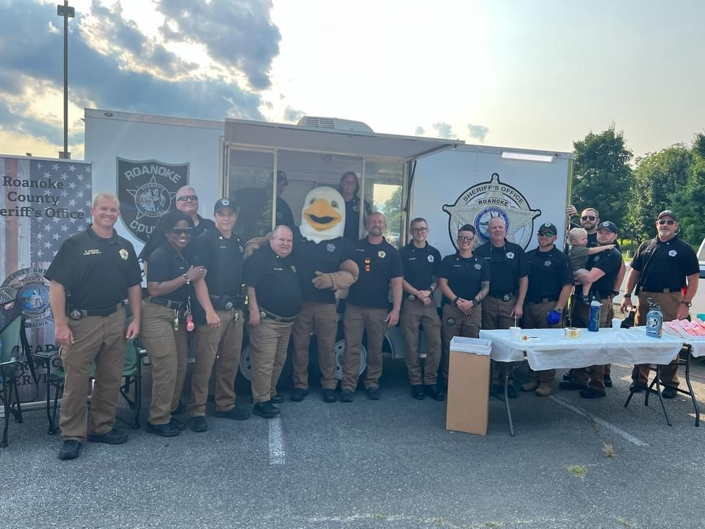
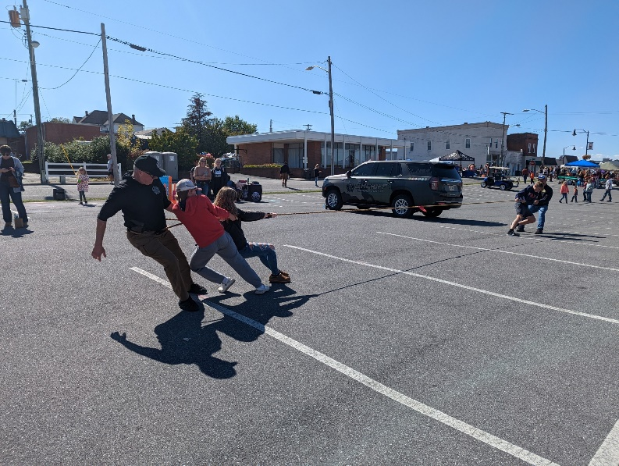
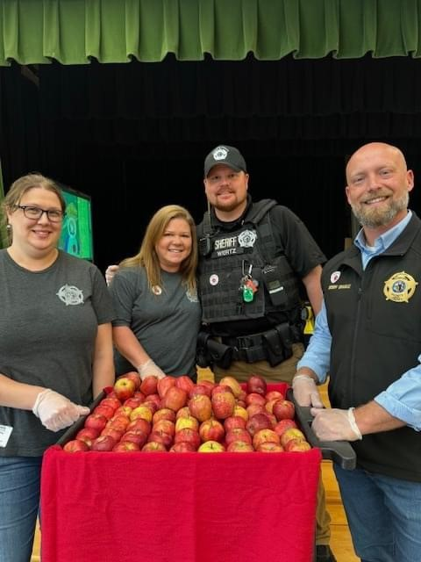
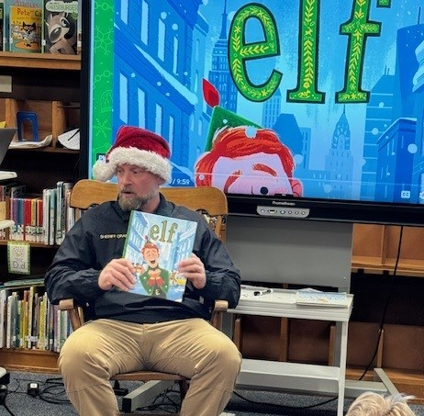
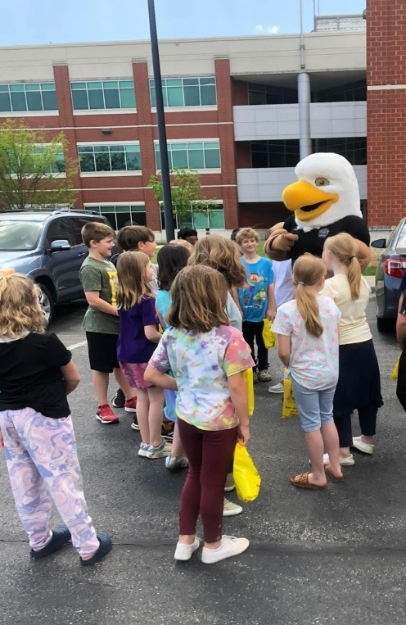
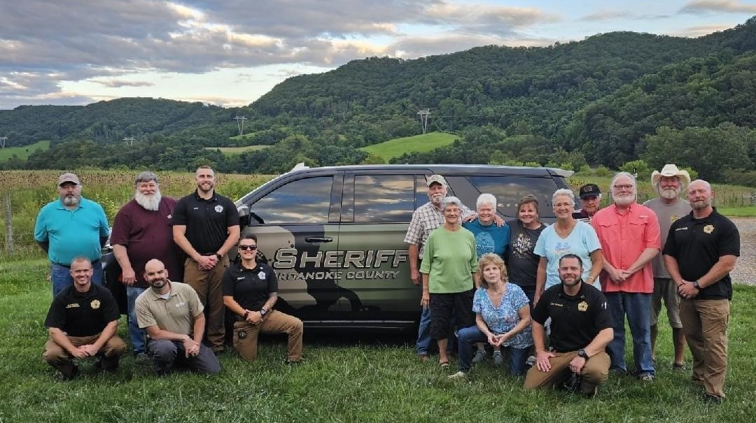
COMMUNITY
The Roanoke County Sheriff’s Office is involved in many community events and fundraisers. Staff and families volunteer their time to many worthy causes.

Slide 20
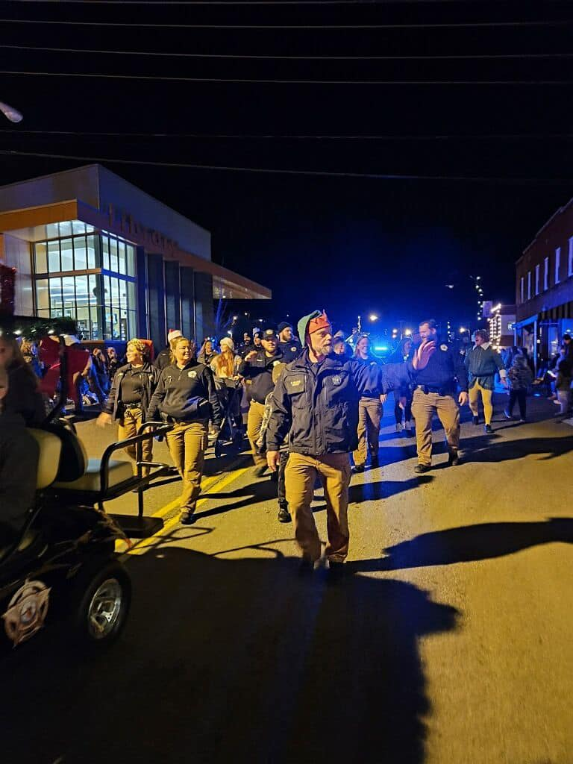
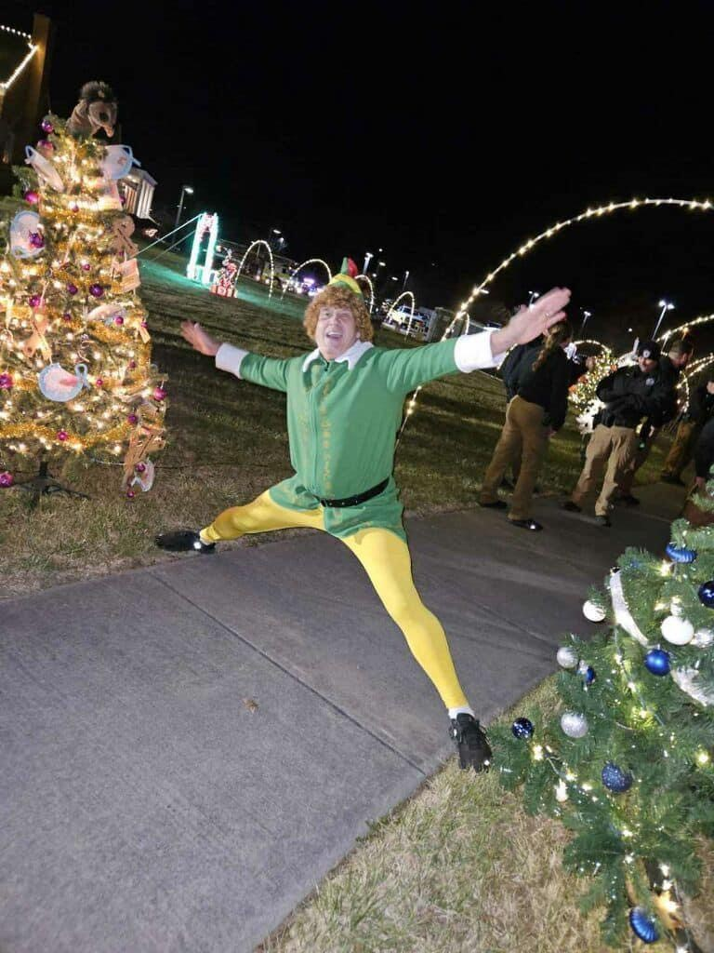
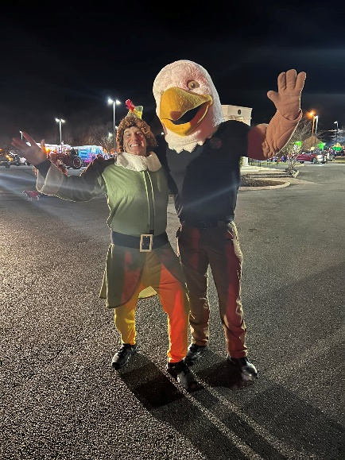
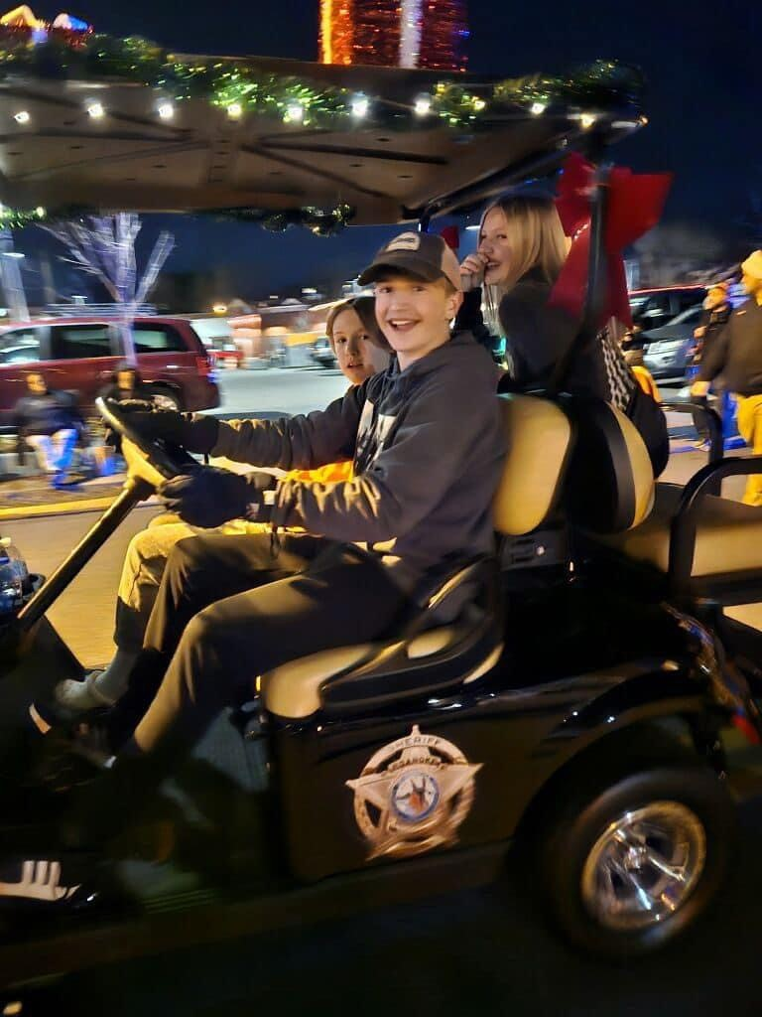
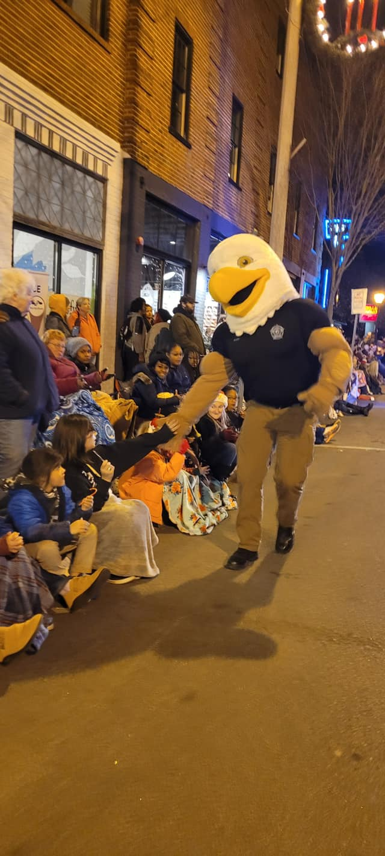
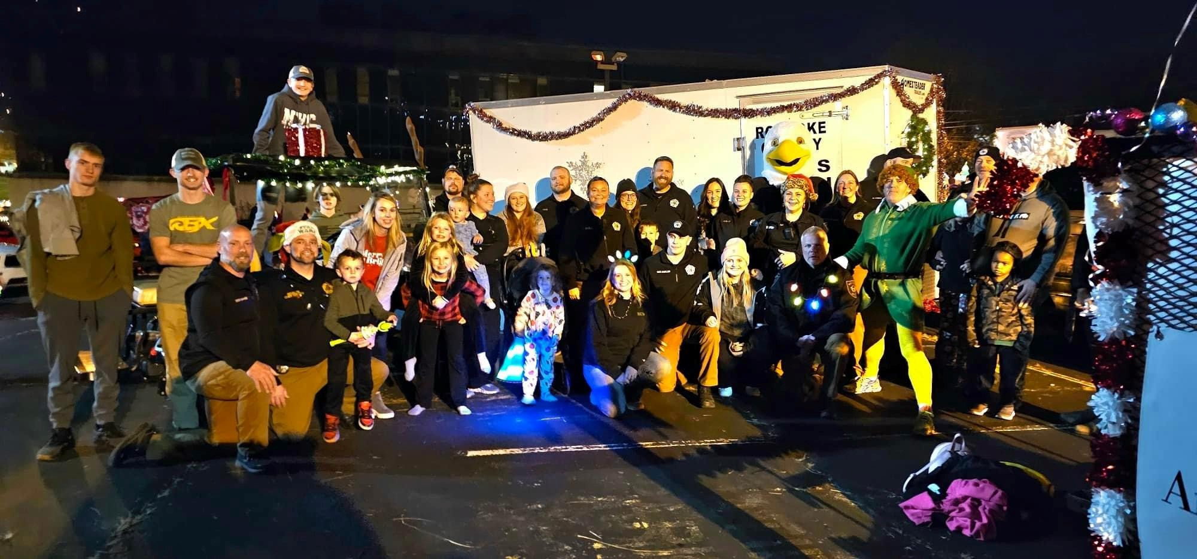
PARADES

Slide 21
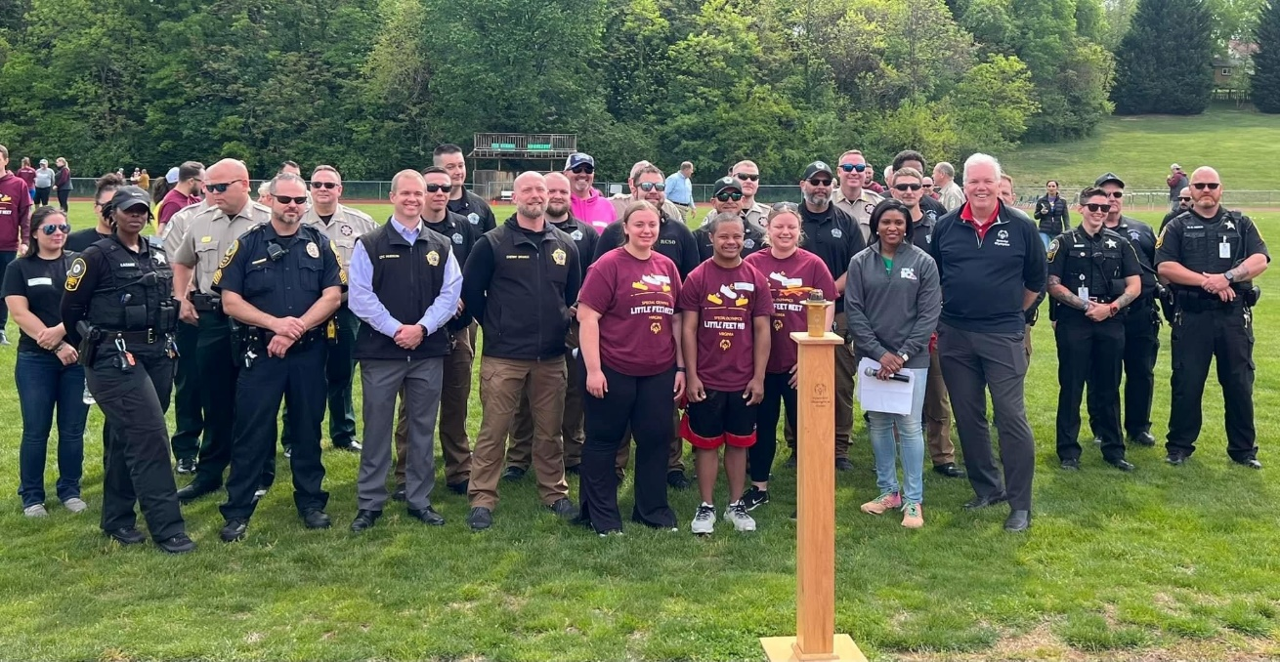
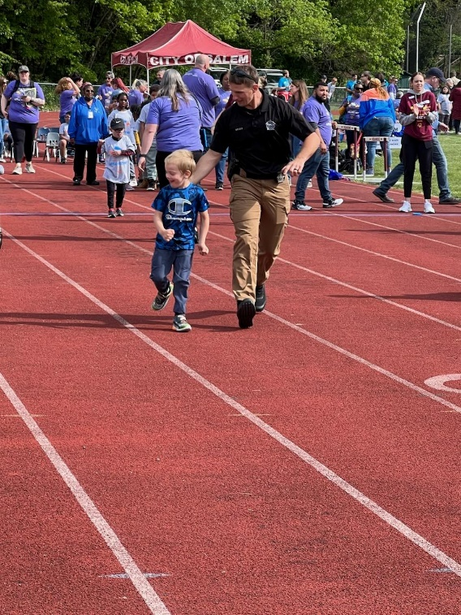
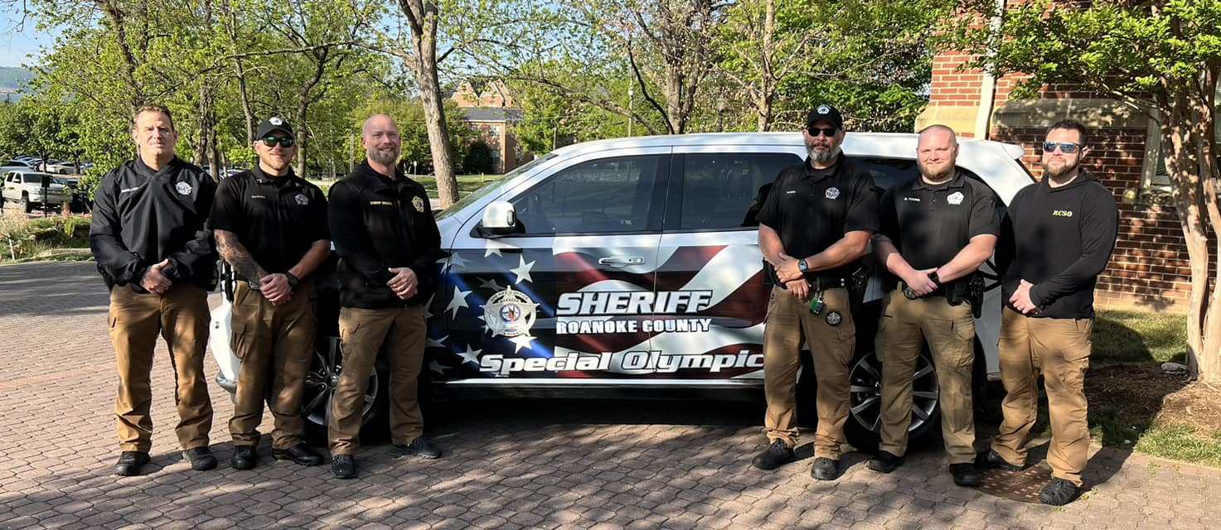
SPECIAL OLYMPICS
Special Olympics of Virginia’s goal is to improve the quality of life for persons with intellectual disabilities through access to sport and recreation programs. The Roanoke County Sheriff’s Office has participated in the Special Olympics fund raising since the early 1980’s. Each year our deputies also participate in the Law Enforcement Torch Run. The Torch Run is a nationwide event and the largest grassroots fundraiser for Special Olympics. The Special Olympic athletes also participate in the run each year. Since the Torch Run was started in the early 1980’s, the Roanoke County Sheriff’s Office has been a leader in fund raising and sponsoring events to raise awareness for Special Olympics. The families of the athletes are touched by the participation of law enforcement personnel and the amount of funds raised by the event. Our deputies give their own time to volunteer in community events including the Poker Run, Golf Tournaments, Little Feet Meet and Shooting Matches. Other winter festivals benefiting Special Olympics the Sheriff’s Office participate in are the Polar Plunge, and Polar Bear Motorcycle Run.

Slide 22

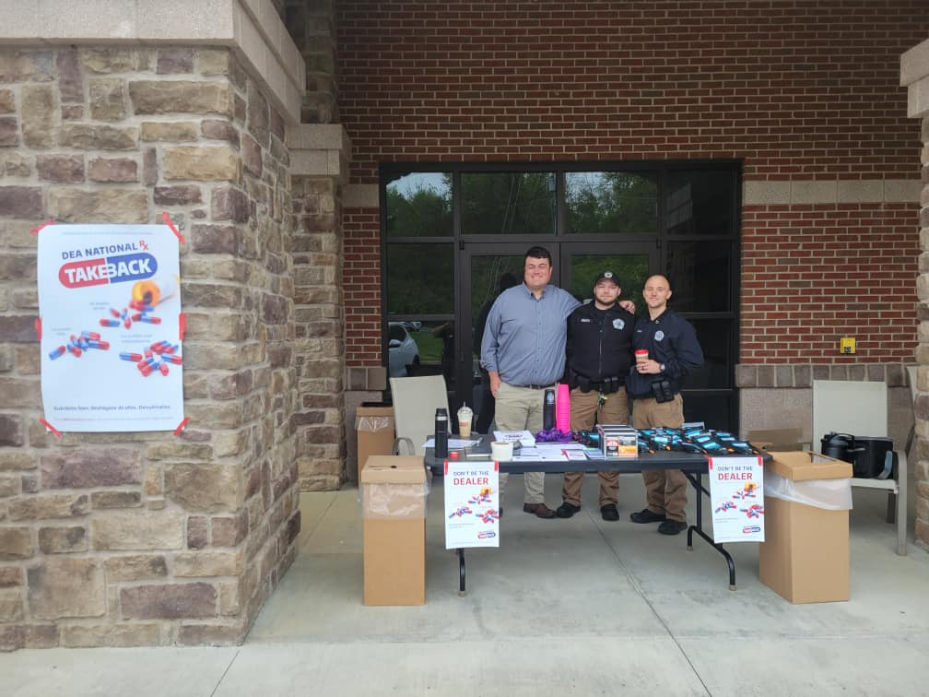
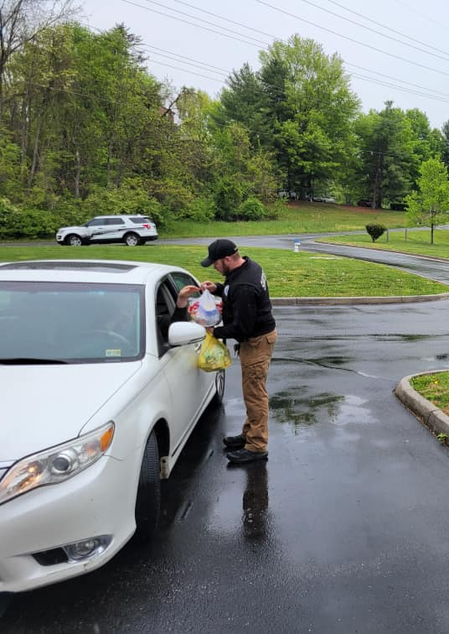
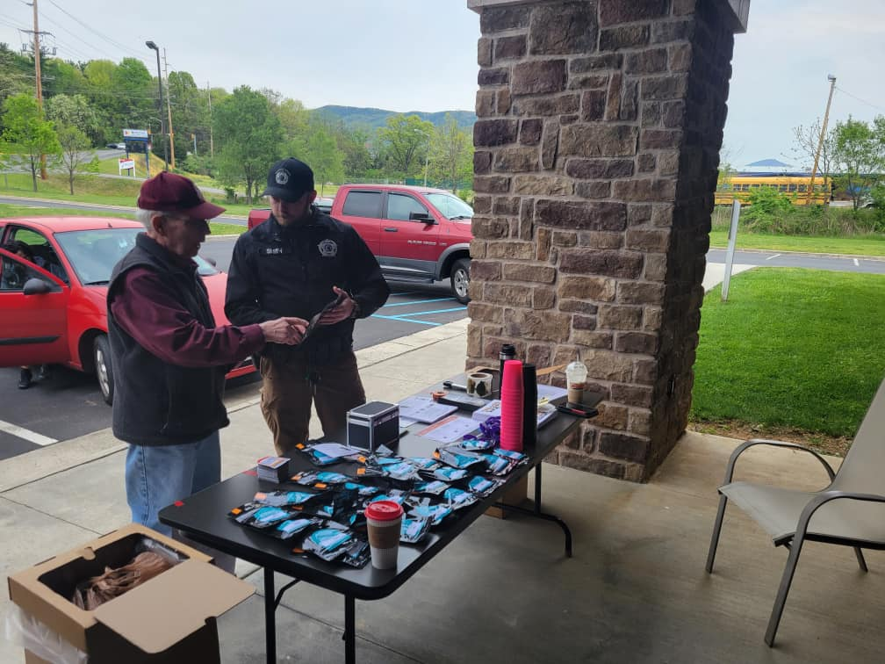
DRUG TAKE BACK BOX
Students from Burton Center for Arts and Technology’s welding class constructed the first public prescription drug take-back box in the Roanoke Valley. The box is installed/located in the Roanoke County Sheriff’s Office lobby. The Sheriff’s Office collected over 300 pounds of drugs in 2023 The unused prescription medication collected is then destroyed under DEA guidelines. The hours to drop off drugs are from 8 AM to 4 PM, Monday through Friday (excluding holidays) at the Sheriff’s Office administrative annex across Main Street from the Roanoke County Court House, in Salem, or one of the local events throughout the year.

Slide 23
SCHOOL RESOURCE PROGRAM
Currently there are three full time SRO Deputies and five part time SRO Deputies that work daily with the Roanoke County Public Schools. These deputies are specifically trained to work in a school setting and have attended School Resource Officer school, threat assessment training, as well as the Law Enforcement Academy. An additional part time SRO is completing required training and will be assigned to the Roanoke County Public Schools (RCPS) in March of 2023.
The main goal of the SRO deputies is to ensure the safety and security of the students as well as the staff at their assigned schools. The deputies also provide criminal investigation services to the RCPS and resources they need to maintain safety, security, order, and discipline in the school environment. The SRO program is intended to ensure that no student’s right to receive an education is jeopardized by violence or disruption.
The Sheriff’s Office has a total of nine SRO’s.
• Eight of the SRO’s are assigned to elementary schools.
• Currently 7 are active and split the schools.
• Five SRO’s are each assigned two elementary schools while the other two SRO’s are each assigned three.
• Following the completion of required training the eighth SRO will be assigned two schools
• At this point each SRO will be assigned to two schools
• The ninth SRO is assigned to William Byrd Middle School
The elementary school day begins at 0730, at which time the deputies are already at their assigned school, assisting staff by helping children out of their vehicles or walking the students from their bus to the school. Once school begins the SRO Deputy checks in with the school secretary and principal to let them know that they are in the school and also to address any issues that they may have. An inside perimeter check is then conducted as well as an outside perimeter check to ensure all exterior doors are secure. While performing the exterior check any suspicious activity that is observed is investigated.
At the conclusion of the day all SRO’s are again assisting the students at the car rider line or walking students to their assigned school bus.
SRO deputies perform a variety of other functions such as teaching safety classes, participating in carnivals, directing traffic, book fairs, career days, the Easter Bunny Program, Red Ribbon Week and many more programs.

Slide 24

LTC. OPERATIONS
Lieutenant Colonel Chad Beheler was raised in Botetourt County and attended Lord Botetourt High School, graduating in 2001. After graduating, he immediately enlisted in the United States Marines. After being honorably discharged, Chad began his law enforcement career with the Roanoke County Police in 2004. Chad attended the Roanoke City Police Academy and, upon graduating, began his training as a road officer. During his 12 years in Roanoke County, he participated in multiple assignments throughout the department. During his last two years at the Roanoke County Police Department, Chad served as the School Resource Officer at Hidden Valley High School.
In January 2016, he was given the opportunity to serve the community as a Deputy with the Roanoke County Sheriff's Office. LT. Colonel Beheler has served as the Community Outreach Coordinator, Professional Standards Unit Sergeant, was appointed as the Administrative Captain, and was most recently appointed as the Lieutenant Colonel of Operations.
Letter from Lt. Colonel Beheler
Upon assuming the role of Chief Deputy of Operations, I transitioned from my previous position as Captain of the Corrections Division. In my new capacity, I took a comprehensive approach to oversee the operations of the corrections and civil divisions, aiming to optimize their efficiency in order to deliver exceptional service to the residents of Roanoke County. I actively engaged with captains and shift lieutenants, prioritizing their input to continually improve both divisions. A key aspect of my role involves coordinating the activities of the various sections within the Sheriff's Office. This coordination is instrumental in ensuring that all personnel carry out their work and projects in alignment with the established goals and objectives of the Sheriff.
I am dedicated to providing well-structured support to our deputies and civilian staff, recognizing their essential role in our daily operations. To accomplish this, I place a strong emphasis on training, particularly for our newly promoted frontline supervisors and field training officers. My commitment lies in furnishing the necessary resources and support to drive the success of our department and its personnel.
I want to extend my heartfelt thanks to all the employees of the sheriff's office for their unwavering display of exceptional professionalism in fulfilling their responsibilities every single day.
Sincerely,
LTC Chad Beheler
Chief Deputy of Operations

Slide 25
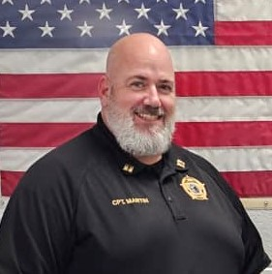
CORRECTIONS DIVISION
Second Shift
Third Shift
Fourth Shift
Inmate Services
Classification
First Shift
Captain Martin
BMartin@roanokecountyva.gov
Services
Records
Medical
Captain Brian Martin began his career with the Roanoke County Sheriff’s Office in 2000. He has served as a deputy in Corrections, Classification, Home Electronic Monitoring, Volunteer Services, and Rehabilitation. He advanced through the ranks as a shift Sergeant and Lieutenant. He transferred to the Civil Division as Civil Lieutenant overseeing all three courts and civil process and later returned to corrections as the Services Lieutenant. In 2023, he was appointed to the rank of Captain and currently serves as the Jail Administrator. He has attended the Professional Executive Leadership School at the University of Richmond, The Batten Institute of Leadership at Hollins University, SPI Executive Leadership School through the University of Louisville, and is a recipient of the FBI Leeda Trilogy award. He graduated from National Business College with an AS in Business Administration with a concentration in accounting. Brian is a Roanoke native and is married with two children.

Slide 26
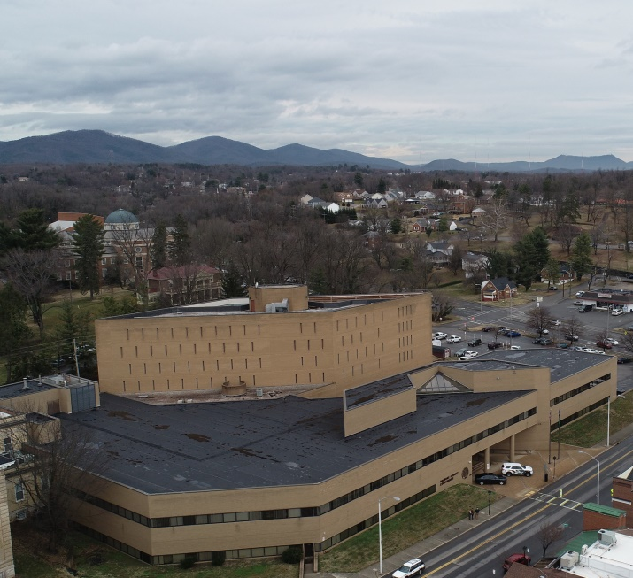
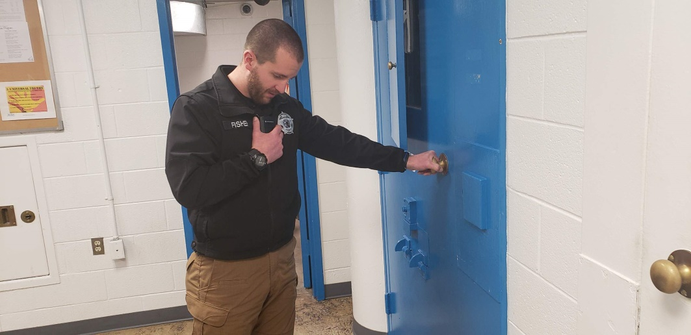
CORRECTIONS DIVISION
The Roanoke County/Salem Jail facility is located at 401 E. Main Street in Salem, Virginia. This facility opened on October 1, 1980 with a rated capacity for 108 inmates. Living units and services for handicapped & disabled inmates are available.
Prior to the construction of this facility, the Sheriff’s Office operated a jail that was only rated to house 24 male and 4 female inmates. While the current facility has a much higher inmate capacity than the previous jail, the inmate population remains consistently above the certified limit. Prior to the opening of the Western Virginia Regional Jail in 2009, the Roanoke County-Salem jail was holding approximately 300 inmates, and contracting the overflow of inmates to other facilities throughout the state. The regional jail opened in 2009 and we were able to reduce our jail population. The average daily inmate population for the year 2023 was 97 inmates.

Slide 27
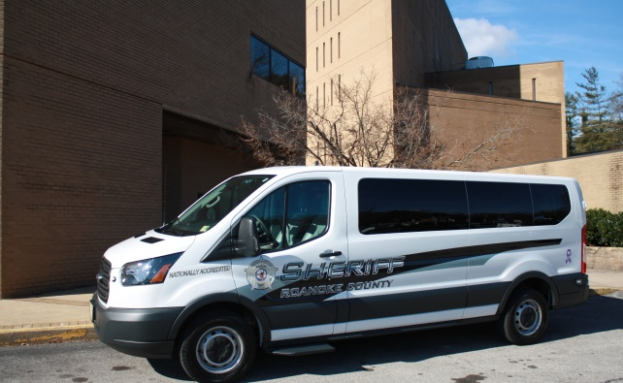
TRANSPORTATION
The Corrections Division consists of two major components: the jail facility & prisoner transport. The Roanoke County/Salem jail houses inmates awaiting trial and those sentenced to less than one (1) year of jail time. Inmates sentenced to terms longer than one (1) year are held until transport to the Western Virginia Regional Jail or a Department of Corrections facility is possible.
The Transportation Deputy manages travels to multiple jurisdictions throughout the Commonwealth of Virginia to pick up incarcerated inmates and returning them to appear before the appropriate Roanoke County Court. They may also have to occasionally take an inmate to and from medical appointments.
2023 Transportation Statistics
Inmates Transported | 1,069
Transport Hours | 2,036
Transport Miles | 78,860

Slide 28
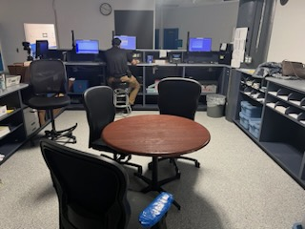
CORRECTIONS
The Roanoke County Sheriff’s Office is proud of our jail and the staff who operate it. It is our philosophy to provide temporary supervised housing for persons entrusted to the Sheriff’s Office’s care, to meet their basic human needs, and also provide programs that will assist those persons in becoming a productive part of society upon release from our jail.
The Roanoke County Sheriff’s Office jail staff work 12 hour shifts. There are two daylight shifts who work of 6:30 A.M. - 6:30 P.M., and two night shifts who work 6:30 P.M. -6:30 A.M.. Each shift is responsible for the supervision and direction of inmates. The shifts are also responsible for maintaining the security and safe operation of the jail, 24 hours a day, 365 days a year. Each shift consists of a Lieutenant, a Sergeant, and 9 to 11 Deputies. The lieutenants and sergeants are responsible for supervising, providing support, and direction to the deputies to carry out the daily operations of the jail.
2023 Booking Statistics
Committals to Jail | 3,323
Releases from Jail | 3,332
Weekender Committals | 345
Inmates Transferred to WVRJ | 900

Slide 29
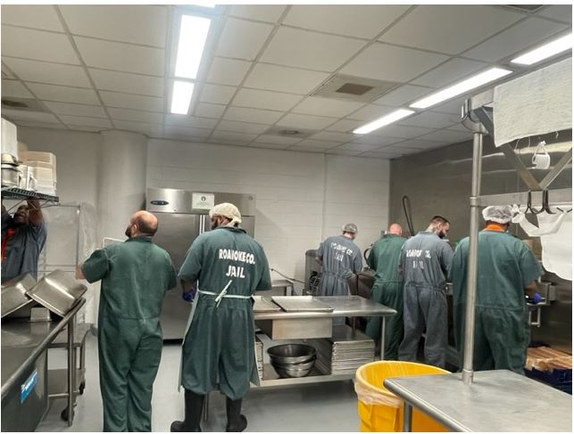
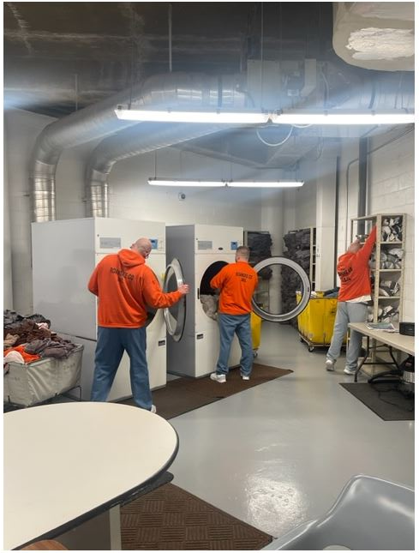
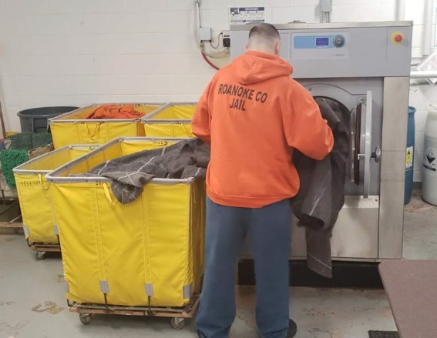
KITCHEN & LAUNDRY TRUSTYS
Food service is provided by a contracted food service vendor. Inmate trusties are assigned to the kitchen to help prepare food and perform clean-up duties. The jail is required to provide three meals a day to the inmates. These meals must be well-balanced with sufficient calories as recommended by the American Medical Association and as approved by a certified dietician as required by state law. Inmates assigned to strenuous work programs or who are classified as trusties are afforded additional nutrition. The cost to feed an inmate per day is $6.30. The expense to feed an inmate for an entire day is less than the cost for a citizen to purchase a single meal at a fast food restaurant.
The laundry is staffed by inmate labor under the supervision of jail staff. Laundry trusties are responsible for ensuring all inmate laundry/bedding and other personal clothing items are received, properly cleaned, and returned to the inmates on a regular basis. Laundry trusties are also responsible for the cleanliness and general upkeep of the laundry area.

Slide 30
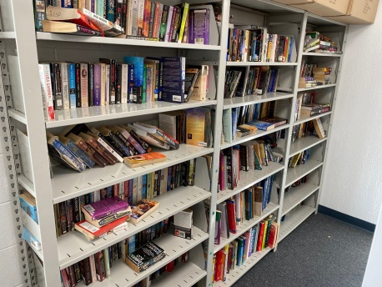
LIBRARY & REHAB SERVICES
During 2023, 3,539 paperback books were available for inmate use. Various educational textbooks and materials are donated by the Roanoke County Schools, the Roanoke County and Salem Public Libraries, Paperback Exchange, and various church groups. Upon request, legal reference materials are made available to all inmates. Numerous counseling and religious services are provided within the jail for any inmate who wish to participate. Inmates who qualify, are encouraged to participate in educational classes and may receive their GED level of education while incarcerated.
AVAILABLE PROGRAMS
SUBSTANCE ABUSE PROGRAMS:
Alcoholics Anonymous
Substance abuse program (ALPHA)
ALTERNATIVE INCARCERATION:
Home electronic monitoring is available, when mandated by court order and contingent upon available space and resources.
LEGAL ASSISTANCE:
Legal Aid Society of Roanoke Valley
COUNSELING PROGRAMS:
Spiritual—individual counseling with Chaplains
Self awareness classes are offered through TAP
Mental health counseling
Parenting classes
EDUCATIONAL PROGRAMS:
GED preparation & testing
Special Education
Access to type legal letters
Law Library
HEALTH PROGRAMS:
AIDS/STD education through the drug rehabilitation program
RELIGIOUS PROGRAMS:
Pastoral counseling
Saturday & Sunday church services
Bible studies
On-site baptismal pool
Spanish Bible study
Life skills class with Chaplain
Chaplain’s class
2023 Volunteer & Program Statistics
# of Volunteers | 41
Hours of Volunteer Services Provided | 767
Inmates Attending Religious Activities | 237
Inmates Attending Self-Help Programs | 527

Slide 31
HOME ELECTRONIC MONITORING
The Roanoke County Sheriff's Office Home Electronic Monitoring program provides an alternative to incarceration for court ordered offenders who meet mandated screening requirements.
Screening:
The initial screening by rehabilitation staff compiles personal, employment and case information about the individual. The offenders’ criminal history, history of substance abuse, and any treatment history is considered. The collective case information enables the rehabilitation staff to determine eligibility for the program according to the Code Of Virginia §53.1-.131.2. If there are no statutory disqualifiers, the staff will conduct a background investigation to determine eligibility for the Home Electronic Monitoring Program.
Guidelines:
No more than 12 months for a misdemeanor or a total combined sentence of 24 months.
No more than a two year sentence for a felony, to include those with a total sentence of 24 months to serve on one or more felony charges.
An individual with up to 12 months of misdemeanor time and 12 months or one year of felony time MAY be placed on Home Electronic Monitoring.
Under no circumstances may an applicant have over two years felony or misdemeanor time to serve in order to be placed on Home Electronic Monitoring.
Background Investigation:
  Verification of address, employment, and phone service.
  Obtaining a criminal history.
  Contacting the individual's Probation Officer, if applicable.
  Review of incarceration history.
The information obtained during the Background Investigation is then compared to the information gathered from the applicant during the Initial Screening Interview. An assessment of the individual's honesty and level of responsibility with regard to their interaction with rehabilitation staff during the screening process, may determine the applicant's eligibility.
Placement:
An offender will be placed on the Roanoke County Sheriff's Office Home Electronic Monitoring Program only after they meet the program requirements as prescribed by the Code Of Virginia §53.1-131.2 and are found suitable during the background investigation. At the time of placement, the offender must sign a written agreement, including consent for submission to random drug testing, and agreement to pay program fees.

Slide 32
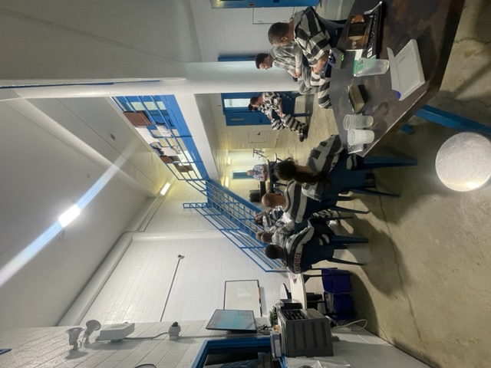
ALPHA PROGRAM
Blue Ridge Behavioral Healthcare administers the Alpha substance abuse program. This program is recognized by the courts as an acceptable treatment program. The Alpha program is a four month inpatient rehabilitative community, followed by an outpatient program upon completion and release. An inmate’s participation in the program by a sentencing court or inmates may request to join the program. Participants are screened by Blue Ridge Behavioral Health personnel before admission to the program. Once accepted into the program, inmates are relocated to the Alpha housing unit and are expected to follow the Alpha code of conduct.
The Alpha code of conduct includes specific times to wake and sleep, restrictions on fraternizing with inmates not in the program, and specific hygiene and cleanliness standards. Inmates in the Alpha program attend scheduled meetings and presentations throughout the day, and are under the direct supervision of the Alpha coordinator from Blue Ridge Behavioral Healthcare approximately eighteen hours a week. Participation in jail-based services may result in immediate entry into intensive outpatient services in the community upon release and provide referrals to other needed services.
2023 ALPHA Statistics
Inmates Participating | 45
Inmates Graduating | 14

Slide 33
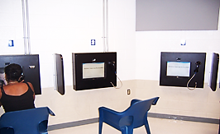
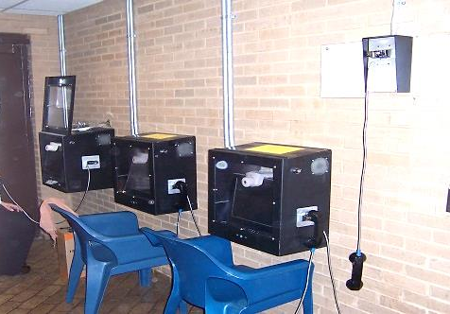
VISITATION
The jail provides a video visitation system that represents the industries leading technologies providing reliable, easy-to-use, high-quality, yet cost effective, and highly scalable IC Solutions. The system, provides the facility with the ability to improve operational efficiency by reducing inmate movement within the jail and frees up staff to concentrate more on safety and security matters. This system allows us to increase the visitation hours, which ultimately benefits the public.
The system is a closed circuit TV platform that is fully recordable by a digital recorder. The system offers several features, such as, variable time set-ups and staff monitoring of visits. The system operates by camera operation at both the visitor’s site and the inmate’s location. The visitor and inmate are seated in front of a monitor and closed circuit camera. Video feeds from each camera will feed into the visitor’s monitor. Audio is transmitted via a telephone receiver on each end. The visitor has the option to visit in the jail lobby, or they can opt to visit from home. Registration for visitation is done through the IC Solutions website: ICSolutions.com.
After the set time limit has been reached, the system will automatically terminate the connection, ending the visitation session.
All visits are recorded on a digital video recorder and may be used in criminal proceedings. The system allows for the investigator to listen to phone calls online at their leisure. Jail staff have the option to turn the recording feature off in the case of attorney and clergy visits. Inmates are also able to order commissary through this system, and check their balances.
Western Virginia Regional Jail
With the opening of the Western Virginia Regional Jail in April 2009, we installed 3 video monitors for visitors to use, so their visitors can visit inmates at the Regional Jail from our jail. This has helped reduce traffic and saved time by citizens not traveling to the Western Virginia Regional Jail for visitation.

Slide 34
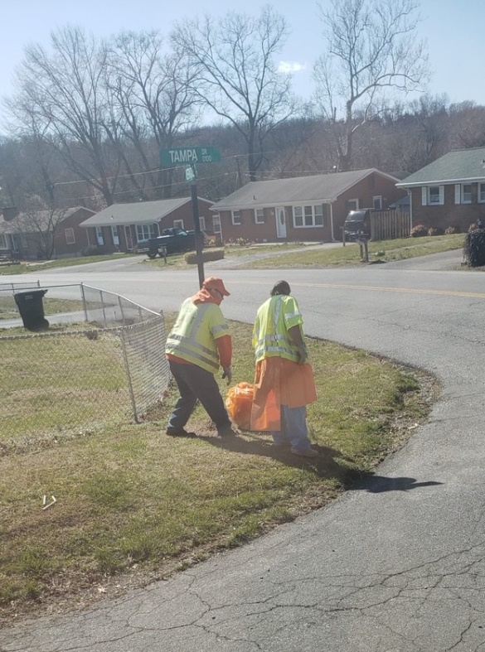
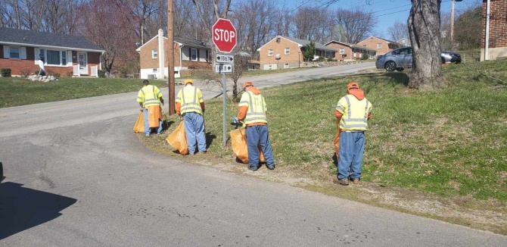
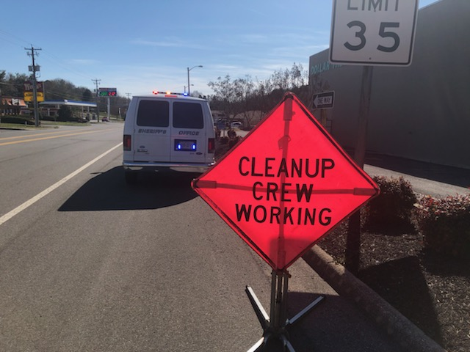
WEEKENDER PROGRAM
The sentencing court may direct offenders to serve their sentence on Fridays through Sundays. Due to the short duration of their confinement, these inmates may not receive visitors. The sentencing court is notified of any violations and subsequent revocations from the program. All weekender inmates are required to work, either cleaning inside the facility or outside the building picking up trash along the Roanoke County roadways. In addition to picking up trash, we receive requests from local schools to perform various work such as mulching, painting, etc.
Weekender inmates must pay the jail $4 per day in addition to $1 per day for daily fees, and $5 for an admission kit fee and drug test fee in order to participate in the weekender program. In 2023, the Sheriff’s Office collected over $2,765 in weekender fees. The weekenders worked a total of 285 hours beautifying Roanoke County roadways and working on County-owned properties. If the hours worked by the inmates were multiplied by $12.22 (minimum average salary of Parks and Recreation Employees without benefits), this program saved the citizens approximately $3,494.92..

Slide 35
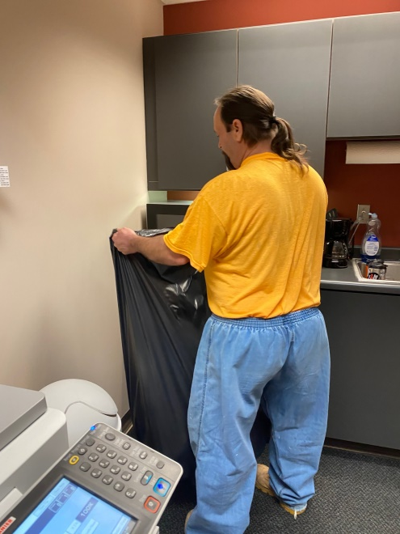

JAIL TRUSTY WORK PROGRAM
The jail utilizes the experience of inmates assigned to our trusty programs. These inmates do not receive any monetary compensation. They are, however, not charged the $1.00/day fee for room and board. Inmates serving as trusties may be eligible for time off their sentences for the work they perform, if they meet the criteria as specified per the policy of the Virginia Department of Corrections.
Trusties are utilized for cleaning Sheriff’s Office vehicles and offices, maintenance of the buildings and grounds, laundry service for inmates, and kitchen duties. Inmates assigned to the work programs receive benefits not available to regular inmates, which may include additional visitation time and additional nutritional allowance for meals.
Inmate labor was provided for several projects this year. Inmates assisted in brush and tree removal and beautification projects at several Roanoke County Schools. Trusties maintain the grounds around the courthouse complex and the jail.
2023 Trusty Statistics
Hours Worked | 60,984
Value of Work ($12.22/hr. wage w/o benefits) | $745,224

Slide 36


WORK FORCE PROGRAM
The inmate work force was established on August 30, 2010, to provide assistance to Roanoke County and provide an opportunity for non-violent and thoroughly screened inmates the opportunity to develop work skills and habits. The work force works closely with the Roanoke County Parks and Recreation Department. Supervised inmates complete weekly projects assigned to them. During the Spring, Summer, and Fall months, two inmate work crews conduct extensive mowing and landscaping activities throughout various Roanoke County sites. These sites include, but are not limited to, public parks, county libraries, fire stations, Camp Roanoke, the fleet center, and road medians across the county.
During the Winters, inmates are assigned to painting projects inside County Buildings, leaf removal, snow removal, landscaping, and trash pick-up throughout the County. The work force is comprised of highly screened and selected inmates that are no danger to the community. These inmates must meet strict criteria to be considered for this program. Selected inmates must be sentenced , they can not have any outstanding warrants, and no more than 3 years left to serve. Inmates would have the opportunity to receive credits which would reduce the length of their sentence, and therefore reduce Roanoke County’s overall cost to house the inmate. In addition, a labor force is provided at minimal cost to the County. Roanoke County Parks and Recreation provide training on the equipment used by the inmates. Currently, there are three inmate work crews. Each crew is supervised by a Deputy Sheriff. The Work Force program operates Monday through Friday, however the working hours may vary depending on the work assignments.
2023 Work Force Statistics
Hours Worked | 7,657
Value of Work ($12.22/hr. wage w/o benefits) | $93,568.54

Slide 37




WORK FORCE PROGRAM
The Roanoke County Sheriff’s Office has established a relationship with the Regional Center for Animal Control and Protection by providing an inmate work crew who assist in walking the dogs and keeping the kennels clean. The kennel staff provide instruction to the inmates on understanding observation of the dogs behaviors, ways to identify behavioral changes in the dogs, and how to safely monitor play groups. Thanks to this program, the dogs enjoy walks three times a day and are able to receive one-on-one attention. Since the initiation of the program they have noticed a decrease in the loudness within the kennels and an improvement in the dogs’ behavior.

Slide 38



INSIDE-OUT PROGRAM
The Inside-Out program was launched in January 2019. The program was paused in 2021, but is slated to resume It consists of 10 Roanoke College Students and 10 inmates taking a criminology college course together inside the jail. Sheriff Orange commented about the program; “I’m a firm believer in the benefit of being a life long learner, so I think it’s great to give them that opportunity to be able to go down the path of further education by earning college credit and I think it’s also advantageous for students who go into a criminal justice field or to take those types of courses to be able to learn one on one with men and women who are incarcerated.”

Slide 39

BRIDGES TO LIFE
Bridges to Life program is a fourteen week program offered to the inmates of the Roanoke County Jail that focuses on victim impact. It is a nationally recognized program that aspires to instill hope and change in the hearts of offenders participating, and embraces victims of crime, promoting healing on both sides.

Slide 40

COURT SERVICES DIVISION
Captain
Mark Crouch
mcrouch@roanokecountyva.gov
Lieutenant
General District Court Sergeant
Circuit Court Sergeant
Administrative Sergeant
Civil Process
Civil Process Clerk
Juvenile Domestic Relations Court Sergeant
Court Services Division Captain Mark Crouch , has served the Roanoke County Sheriff’s Office since 2000. He is responsible for managing the Court Services Division, and the Inmate Work Force program.

Slide 41



The Court Services Division includes civil process and court security. The primary objectives of the Court Services Division are to provide a secure and safe environment, and maintain order in the Roanoke County Courthouse and to also serve all civil process papers in an efficient and timely manner. In 2023, our Civil Process Servers performed service of over 66,426 papers. There are currently three Deputy Sheriffs serving as full time Civil Process Servers.
CIVIL PROCESS
The Court Security Unit is comprised of 22 full and part-time Deputy Sheriffs. These deputies provide security for 2-3 General District courtrooms, two Juvenile & Domestic Relations courtrooms, 2-3 Circuit courtrooms, and staff the security checkpoints on each side of the Courthouse Complex.
In addition, these deputies provide security for the Virginia Court of Appeals approximately 25 times per year, when they meet in the Roanoke County Courthouse. These deputies ensure the safety, and security of judges, court staff, jury members, visitors, and prisoners, by providing security and control and carefully monitoring court proceedings.

Slide 42



COURT SECURITY
Deputies screen courthouse visitors through the use of metal detectors, hand held metal detectors, x-ray machines and visual inspections of the visitor and their possessions. Deputies screen more than 93,452 citizens through the check points each year. This initial contact between deputies and citizens provides both parties an opportunity for positive interaction. Deputies provide assistance by answering questions and providing directions within the courthouse. Our hope is to help citizens feel secure and safe while visiting the courthouse.
With the limited amount of resources, court security staff strive to find creative ways to be pro-active problem solvers. This involves early detection of potential trouble and a swift and effective response. It also encourages everyone who participates in court security, to contribute ideas to make the courthouse secure and to ensure smooth operation for the courts. Fourteen years ago, we successfully implemented a security checkpoint for the General District , Circuit Court, and Juvenile & Domestic entrance.

Slide 43


HONOR GUARD
The Sheriff’s Office Honor Guard participates in numerous events throughout the Commonwealth to include: Investiture ceremonies and swearing-in ceremonies for Sheriff’s Office personnel and elected officials, Law Enforcement Recognition, Various Roanoke Valley Parades, Vinton Dogwood Festival, and the annual Roanoke Valley Law Enforcement Memorial Service. The Honor Guard is available upon request to participate in public functions.

Slide 44


EMERGENCY RESPONSE TEAM
The Sheriff's Office maintains a specialized Emergency Response Team (ERT) whose members are carefully selected and trained to respond and resolve emergency situations. There is also a team of trained negotiators attached to the ERT who can respond to hostage situations, barricaded subjects, and suicidal individuals. This ERT is responsible for supplying special tactical assistance to the jail, courthouse complex, Roanoke County, and surrounding jurisdictions when needed. Mandatory training is required by all ERT members each month, as well as specialized training to keep up to date with their skills and emergency procedures. All ERT members have specialized training in firearms, special impact munitions, chemical munitions, high risk warrant service, hostage rescue, barricaded subjects, correctional emergency response, and high risk prisoner transportation. ERT members provide a valuable service to the community by assuring order and safety in emergency or unusual situations.

Slide 45




PROMOTIONS

Slide 46



PROMOTIONS

Slide 47






Slide 48




PROMOTIONS

Slide 49




SERVICE AWARDS

Slide 50




SERVICE AWARDS

Slide 51





RETIREMENT

Slide 52
2023
Roanoke County
Sheriff’s Office
Annual Report

